Slide 1

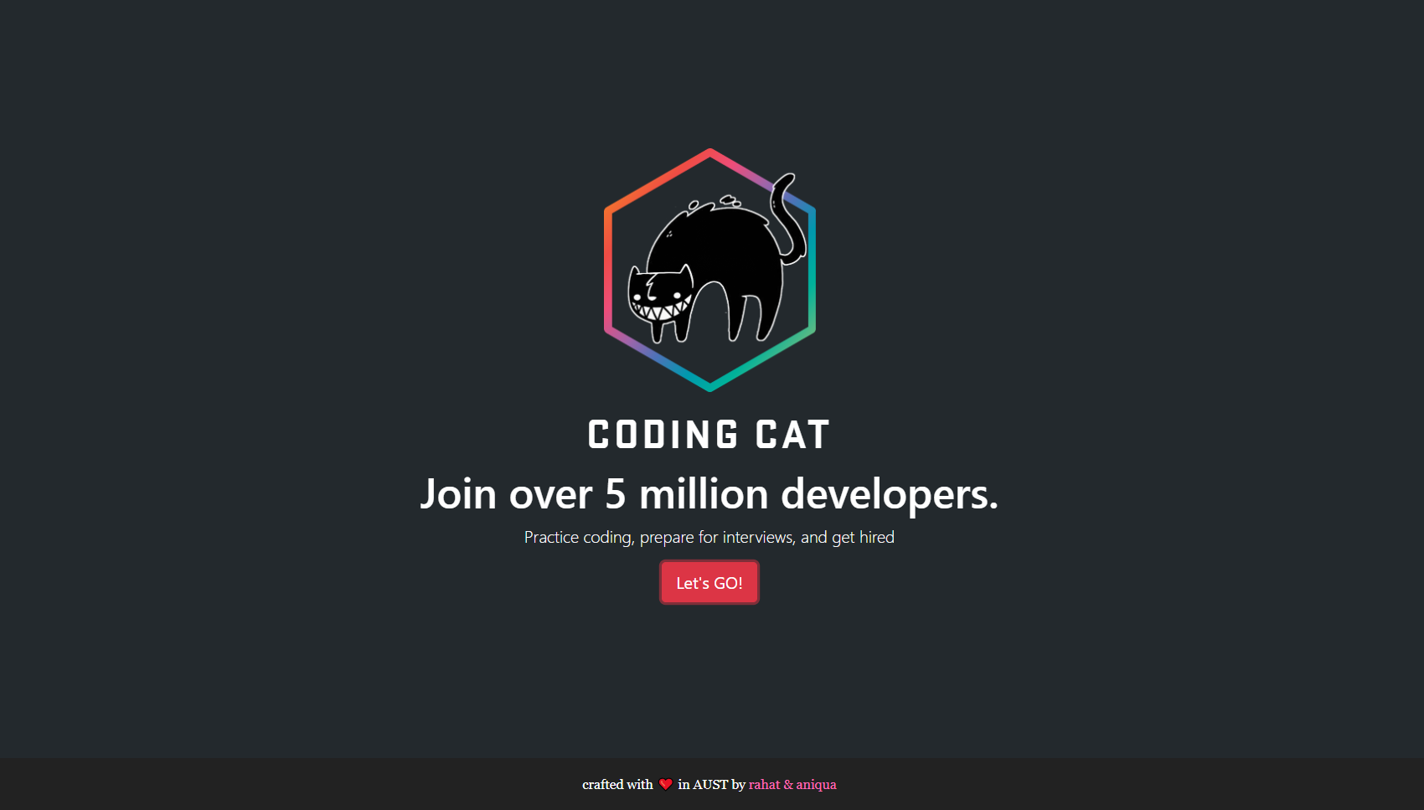


Coding Cat
Ahmad Subaktagin Jabir 16.02.04.061
Arunima Ayshee 16.02.04.066
Rahat Bin Osman 16.02.04.083
Aniqua Tabassum 16.02.04.085

Slide 2
Outline
Project Motivation
List of Primary Actors
List of Secondary Actores
Use cases according to the Primary Actors
Conclusion
September 03, 2019
Coding Cat

Slide 3
Project Motivation
September 03, 2019
Coding Cat

Slide 4
Build a system where:
Programmers can practice industry standard problems and give assessment tests.
Companies can hire talents.
September 03, 2019
Coding Cat

Slide 5
List of Primary Actors
September 03, 2019
Coding Cat

Slide 6
Talent
Project Manager
Problem Setter
September 03, 2019
Coding Cat

Slide 7
List of Secondary Users
September 03, 2019
Coding Cat

Slide 8
Talent
Project Manager
Banking Service (bKash,Credit Card)
September 03, 2019
Coding Cat

Slide 9
Use cases according to the
Primary Users
September 03, 2019
Coding Cat

Slide 10
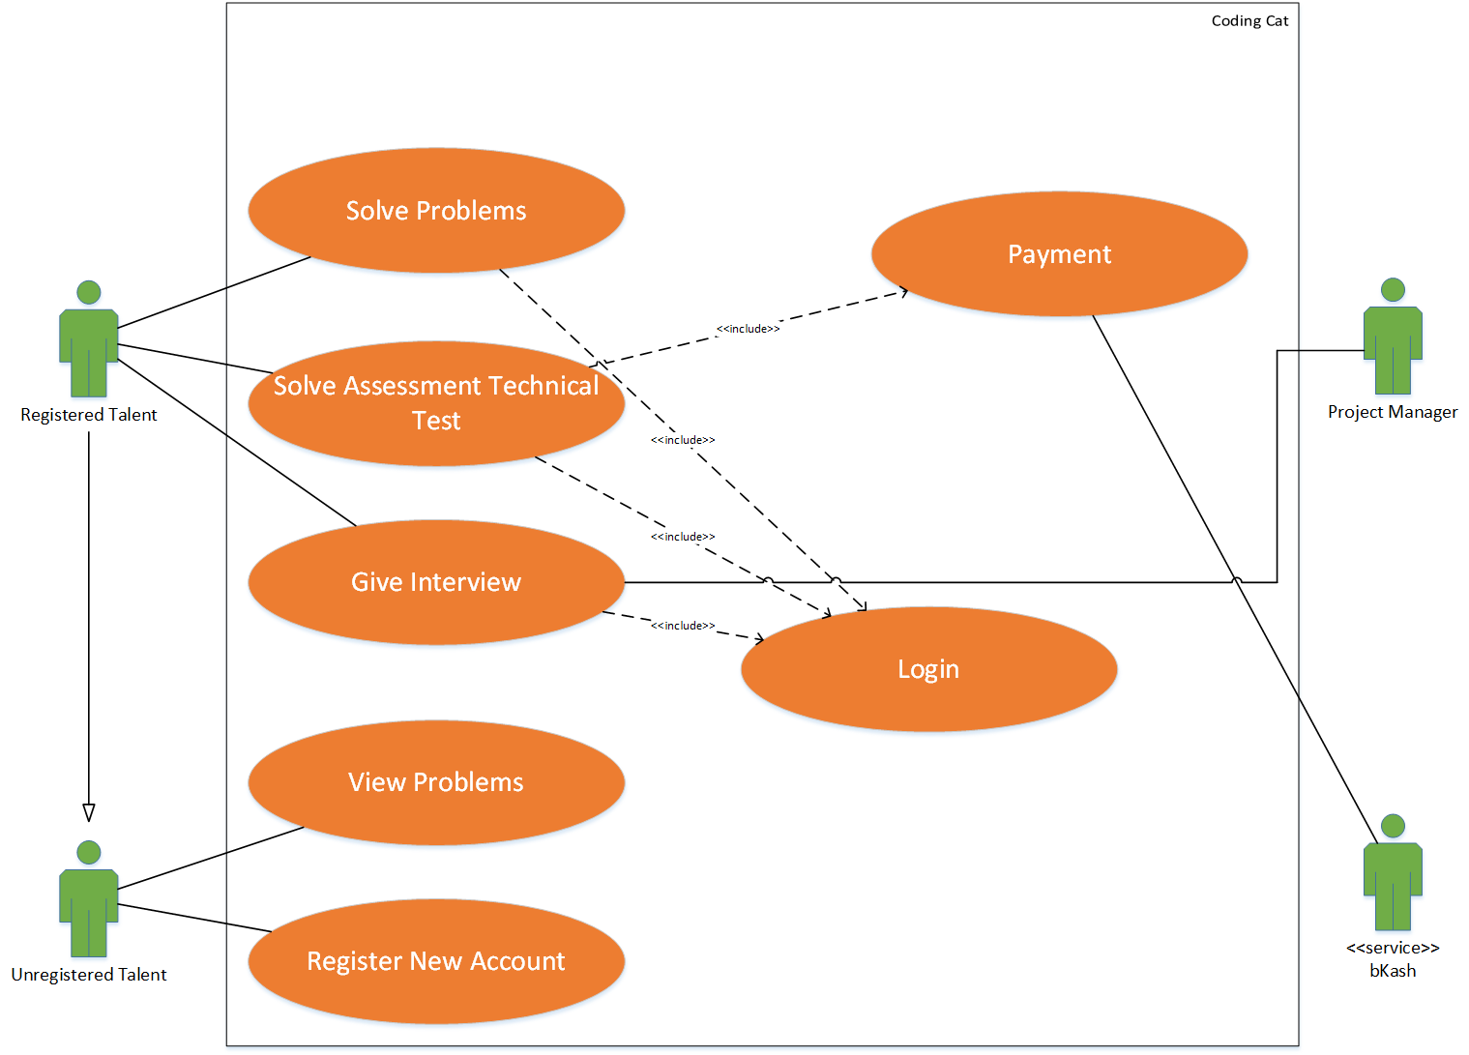
Use Case Diagram of Talent
September 03, 2019
Coding Cat

Slide 11
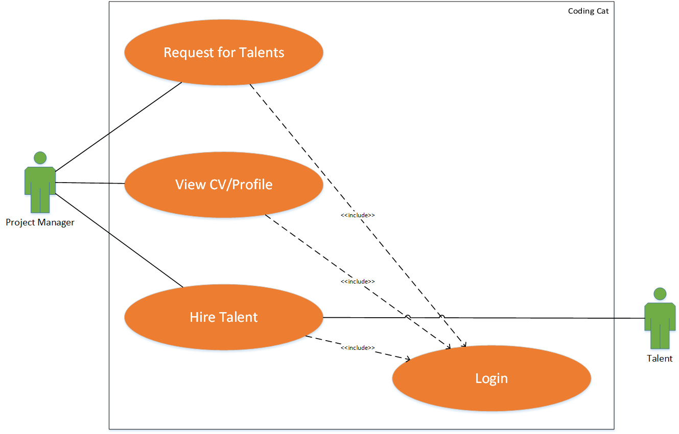
Use Case Diagram of Project Manager
September 03, 2019
Coding Cat

Slide 12
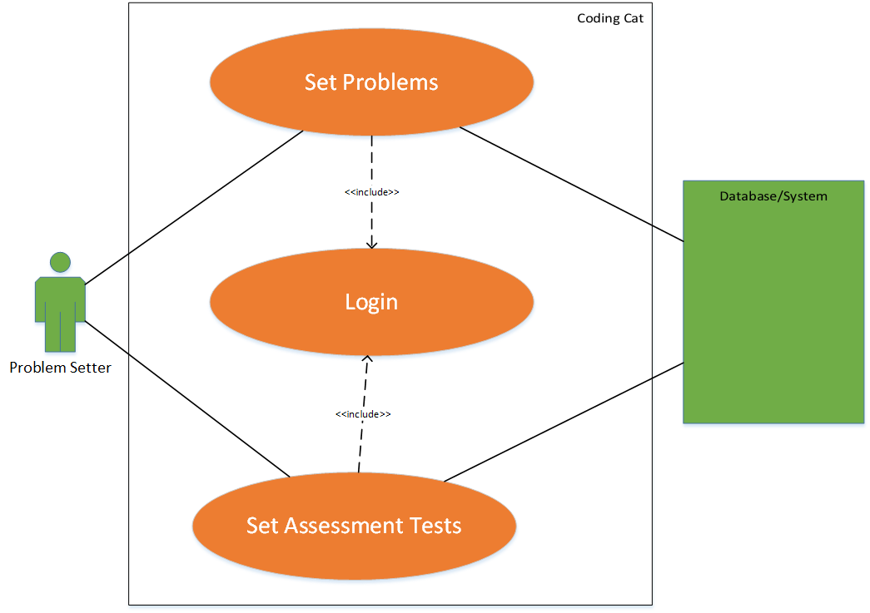
Use Case Diagram of Problem Setter
September 03, 2019
Coding Cat

Slide 13
Conclusion
September 03, 2019
Coding Cat

Slide 14
Having a clear understanding of what a system should do is significant for project managers, developers and clients to coordinate.
We have tried to make the use case diagrams as clear as possible so that no confusions can arise in the development phase.
All the scenarios have been included in the diagrams.
Hard and loose coupled relationships have also been mentioned.
September 03, 2019
Coding Cat

Slide 15
Thank You
September 03, 2019
Coding Cat

Slide 16
Any Questions?
September 03, 2019
Coding Cat

